Slide 1


Tesla Global Delivery & Performance Analysis
Presented by: Suman Saha — Data Analyst
Data Source: Tesla Dashboard Analysis (2015–2025)

Slide 2
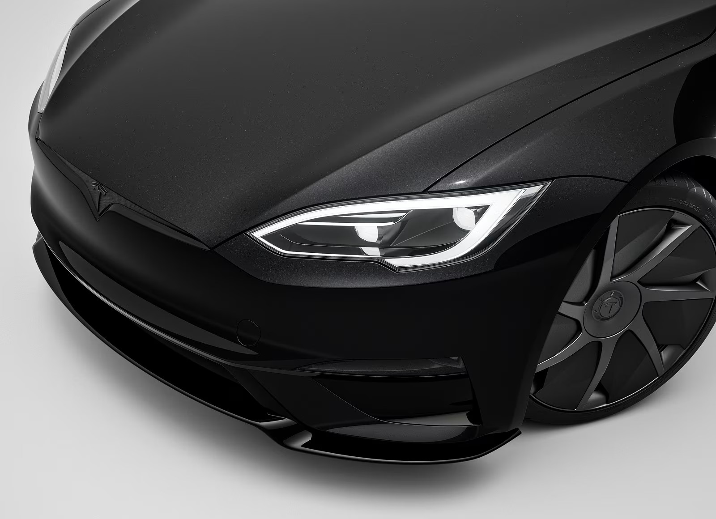







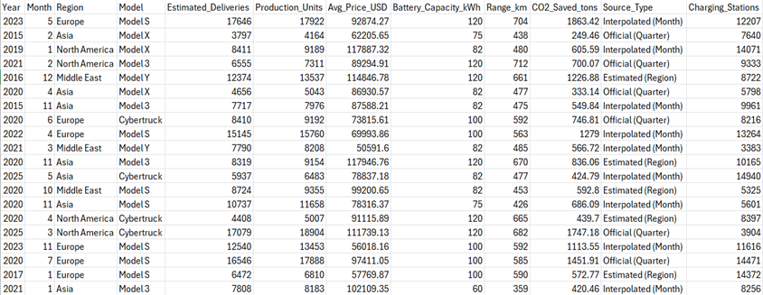

Problems :Understanding Tesla's Complex Global Landscape
Performance Snapshot
26.19M
Delivery Comparison
Regional Variance
Total Deliveries
Difficult to benchmark performance across multiple vehicle models
Market dynamics differ significantly by geography
-1.6%
CO₂ Impact
Market Share Shifts
YoY Growth
Environmental savings vary by model and adoption rate
Competitive landscape constantly evolving
Dataset Overview
~750
5 Tesla Models
11-Year Timeline
Avg CO₂ Saved (tons)
Model S, Model 3, Model X, Model Y, Cybertruck
Complete delivery data spanning 2015–2025
$85K
Avg Vehicle Value

Slide 3
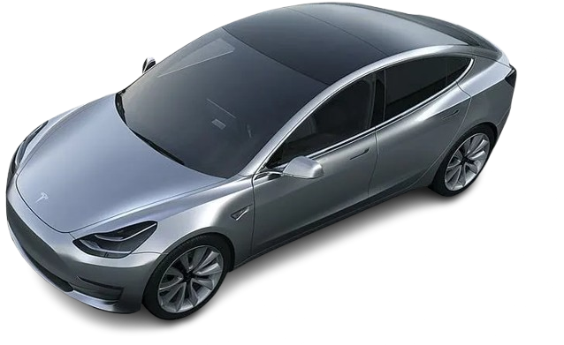
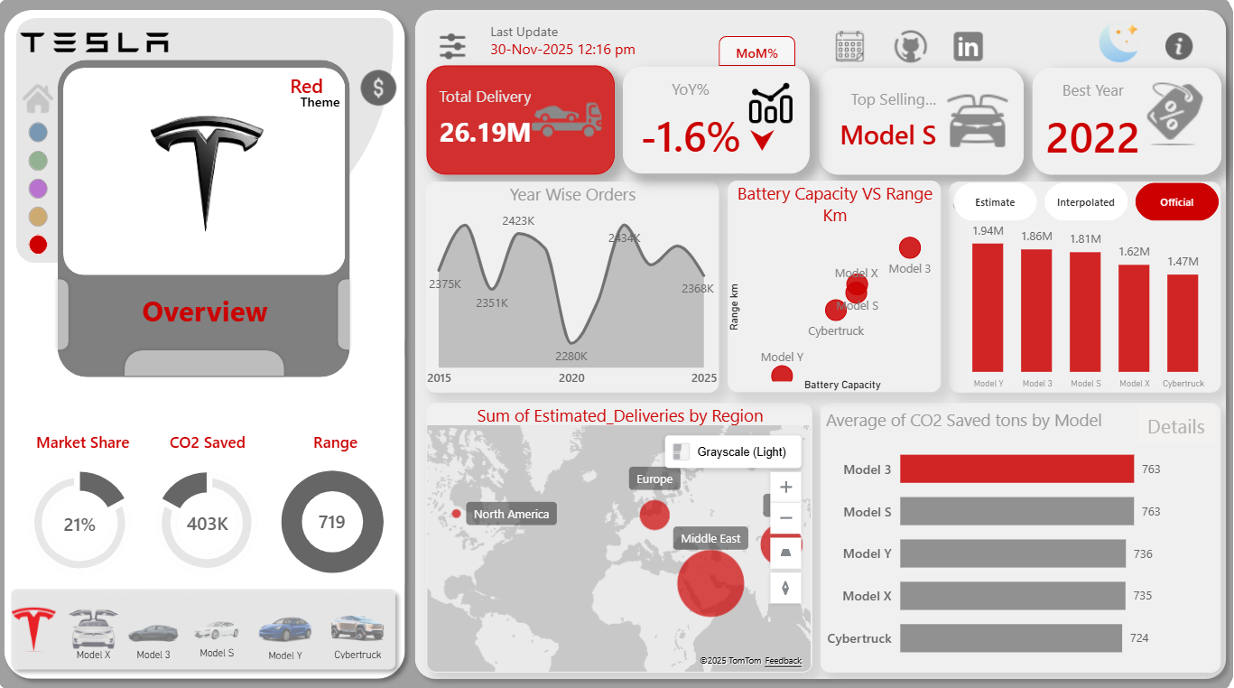
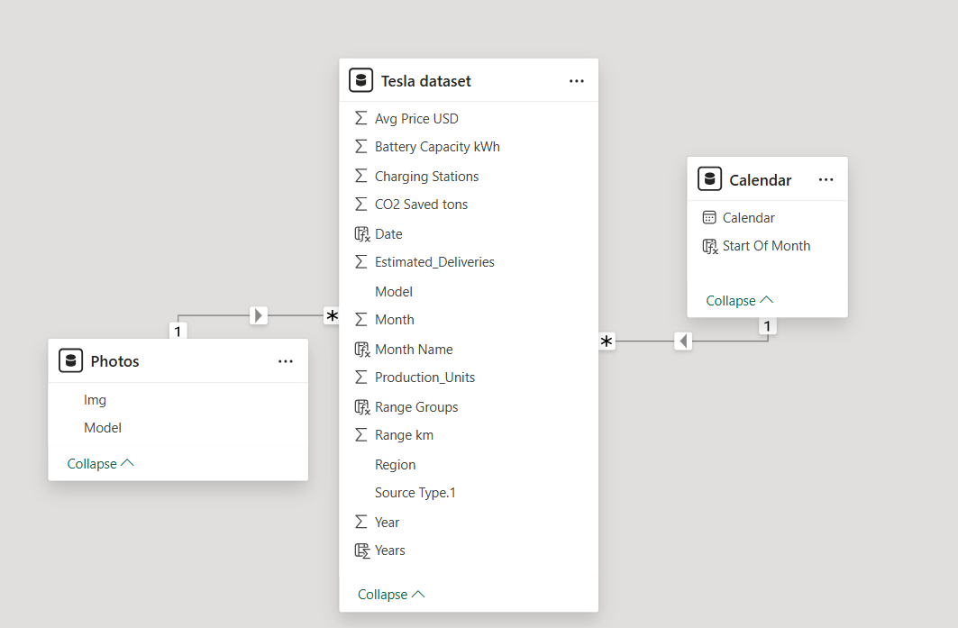
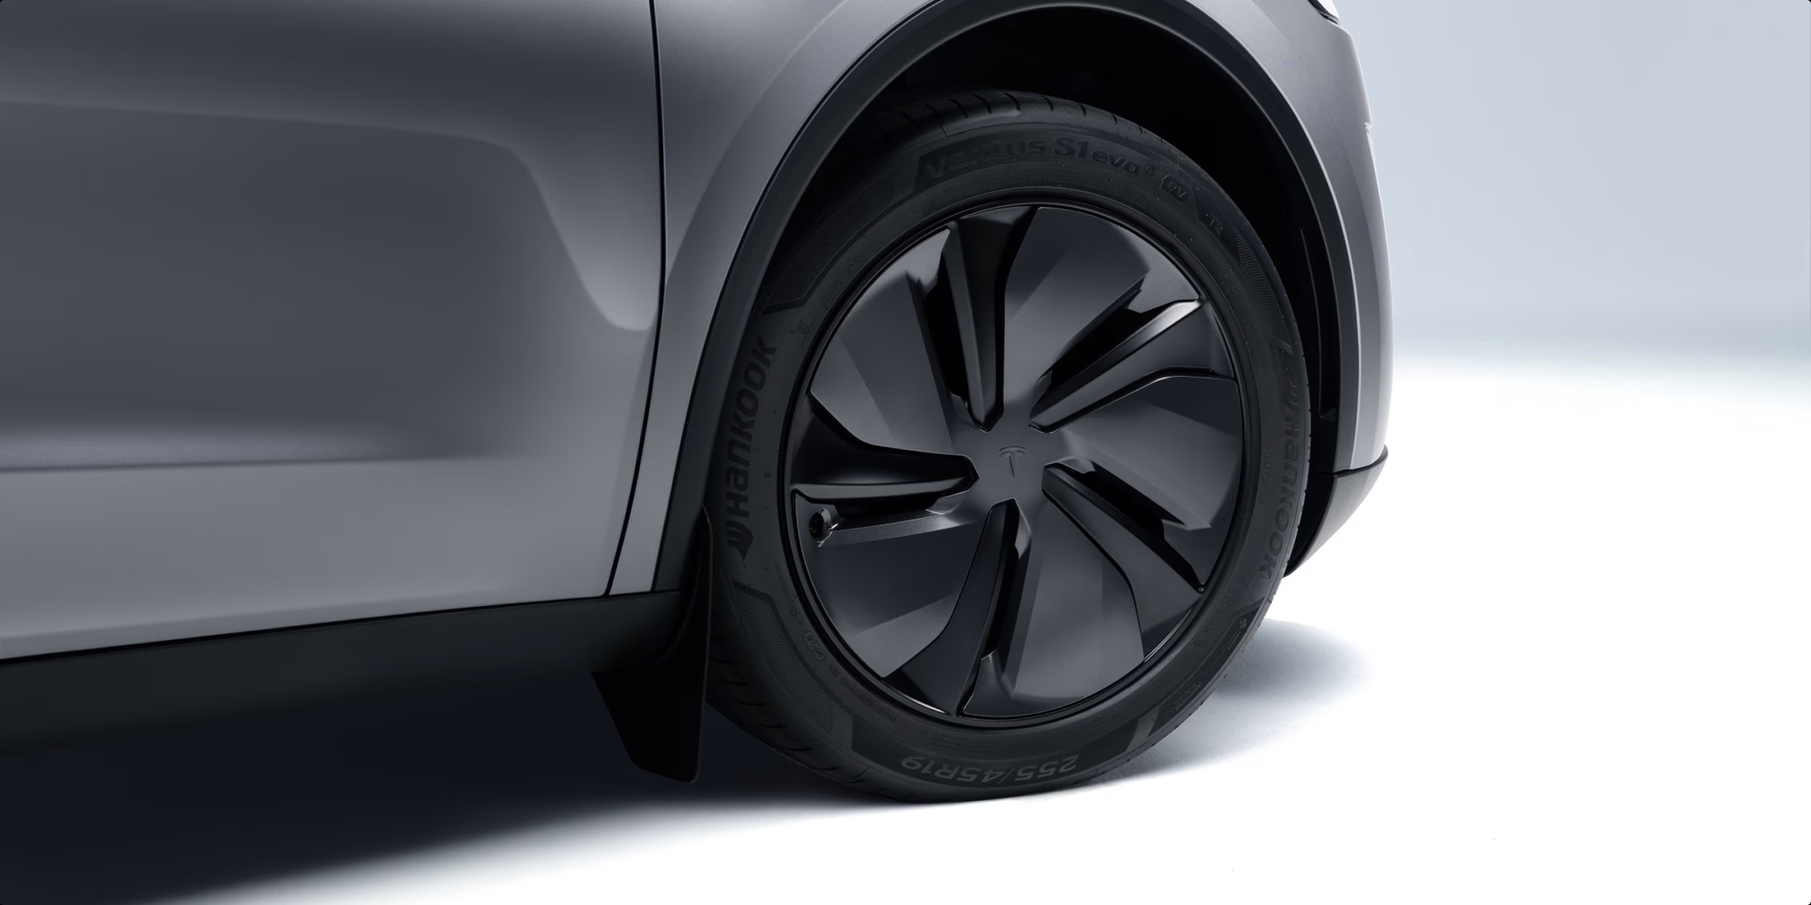
Data Modeling
Key Performance Metrics
Total Delivery Volume
Top Performing Model
Peak Sales Year
26.19M vehicles delivered across all models
Model S leads in market dominance
2022 marked Tesla's strongest performance

Slide 4


Delivery Trends: 11-Year Performance Journey
1
2015–2017
Early growth phase — Model S & Model 3 establish foundation
2
2018–2020
Acceleration period — Model Y peaks in 2018, strong expansion
3
2020–2022
Peak performance — Highest delivery volumes across portfolio
4
2023–2025
Stabilization — Cybertruck peaks 2024, slight overall decline after 2023
Key Insight: Model S & Model 3 show consistent strength year-over-year. Tesla maintains robust performance despite post-2023 softening.

Slide 5
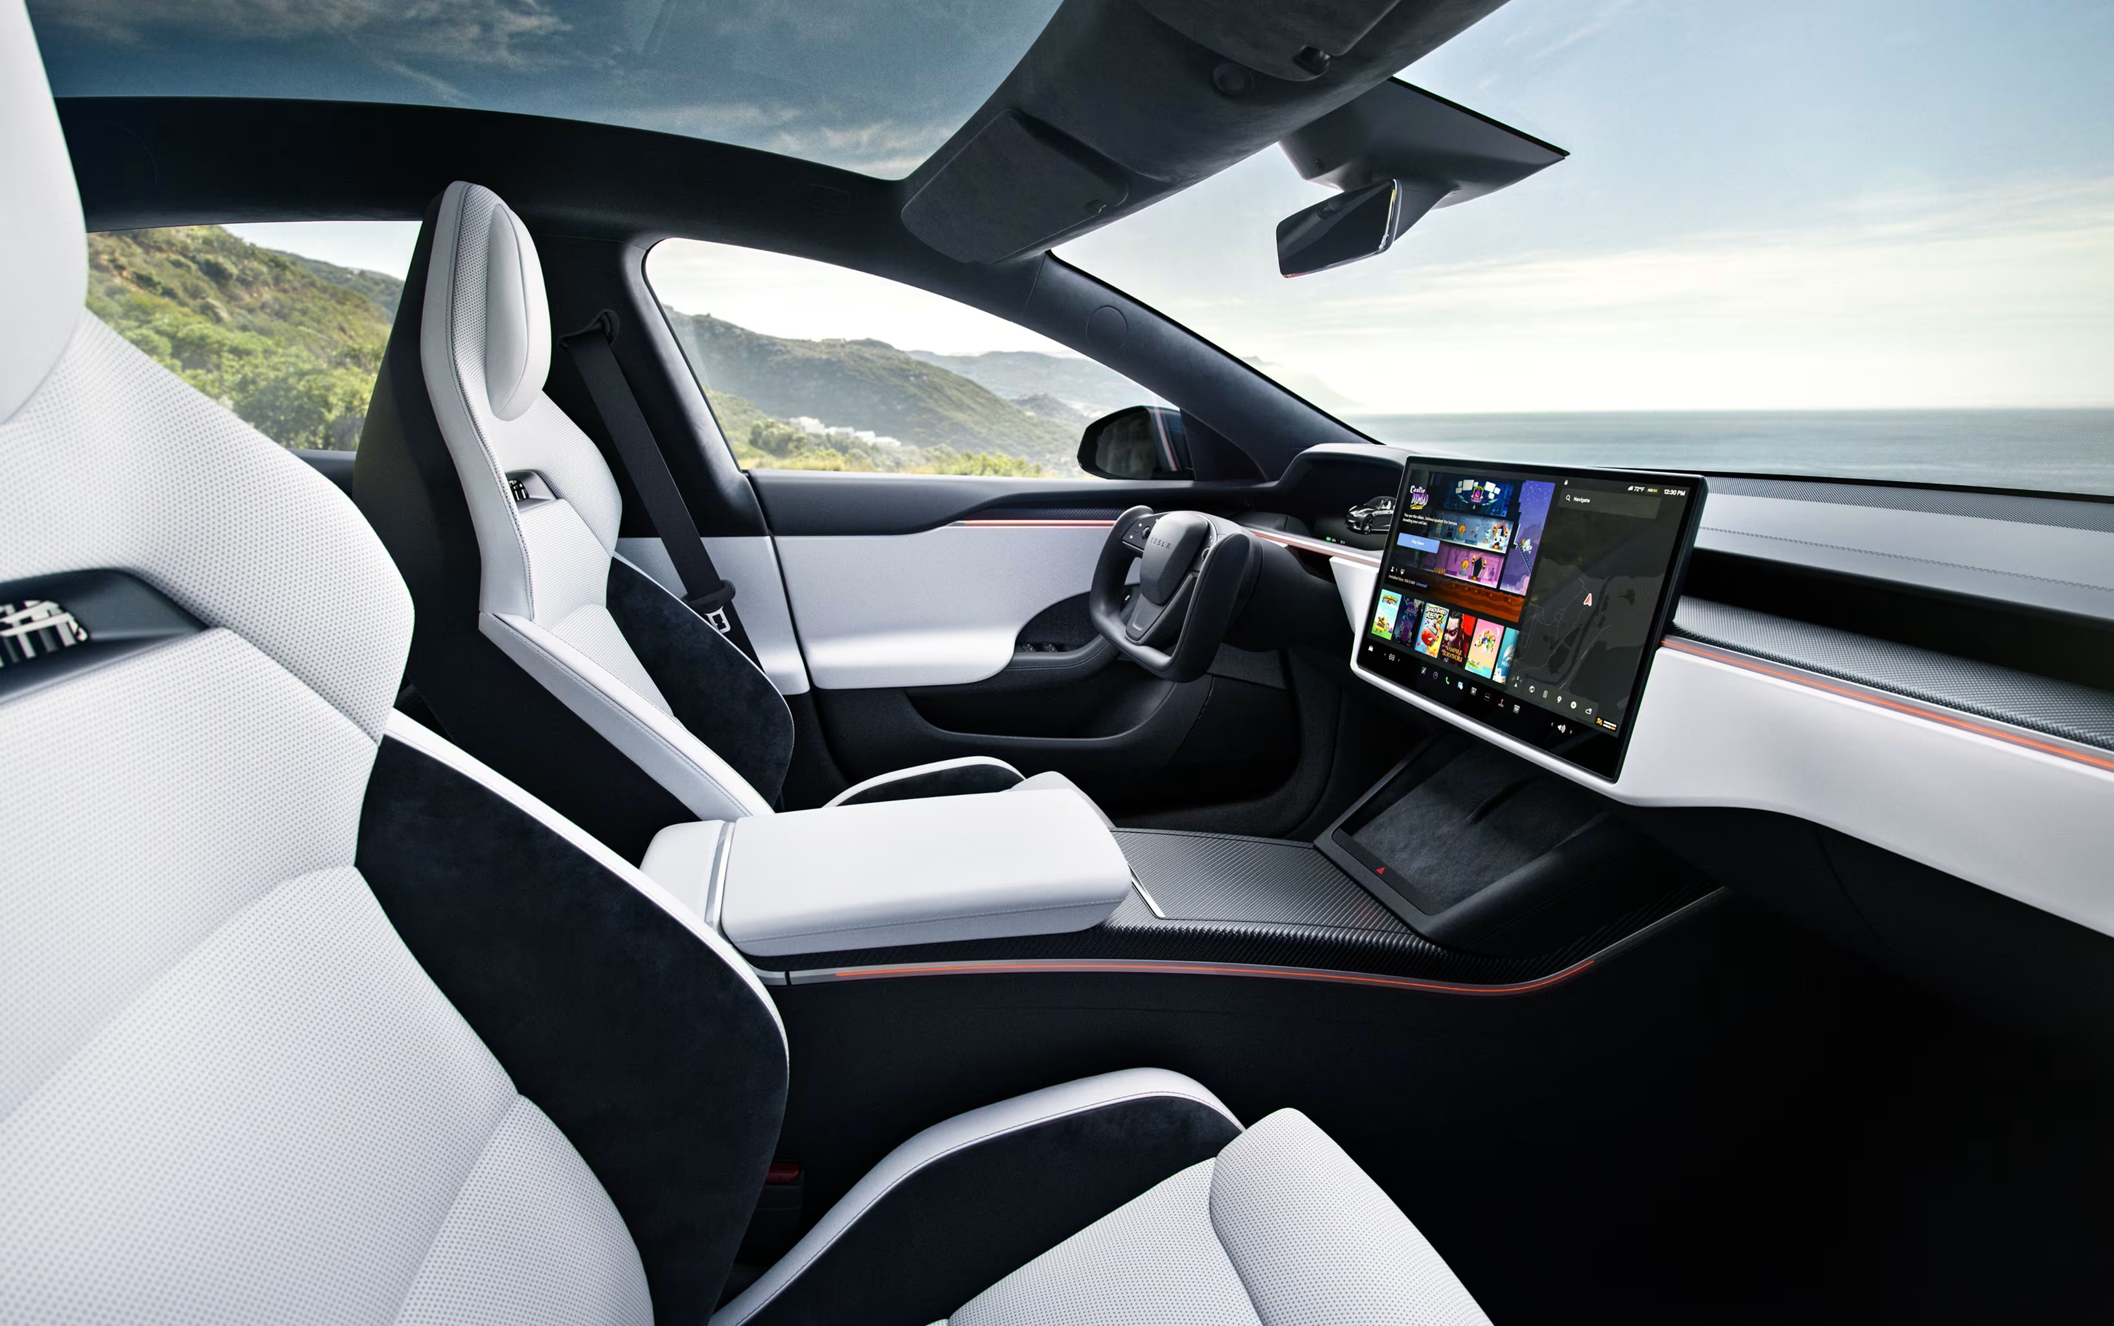






Regional Performance: Geographic Market Dynamics
Middle East
Emerging market — lowest volume but showing growth trajectory
Asia
Stable mid-tier contributor with consistent delivery volumes
Europe
Strong secondary market — reliable mid-to-high level performance
North America
Dominant leader — highest deliveries every year across all models
"North America remains Tesla's powerhouse, while emerging markets present significant expansion opportunities"

Slide 6
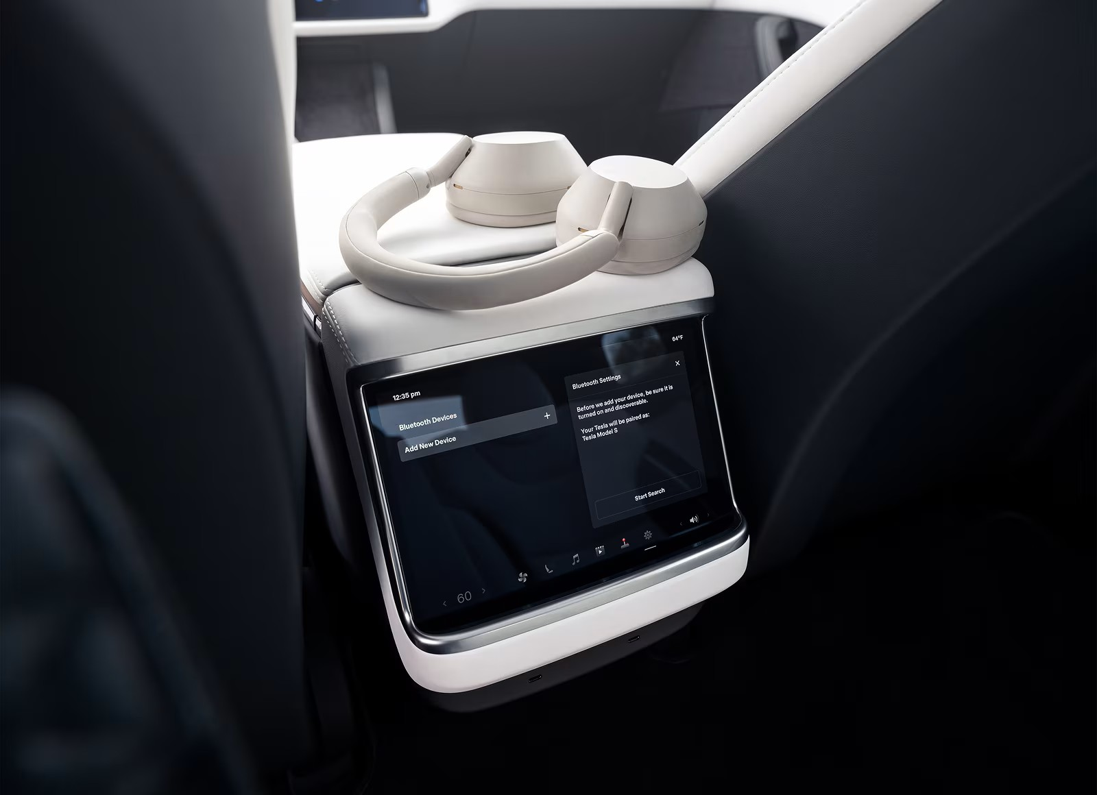

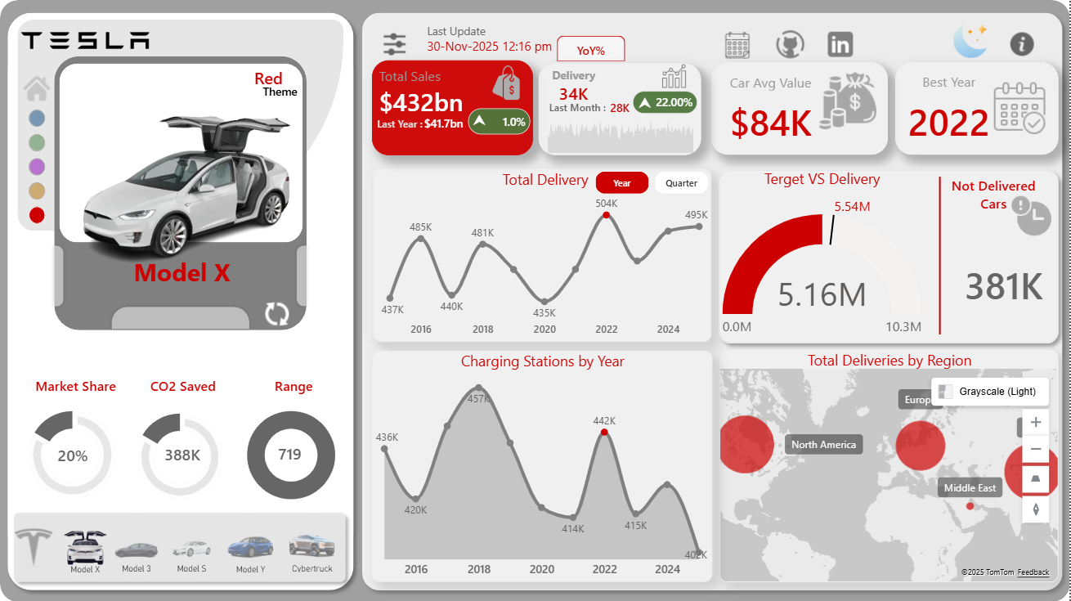
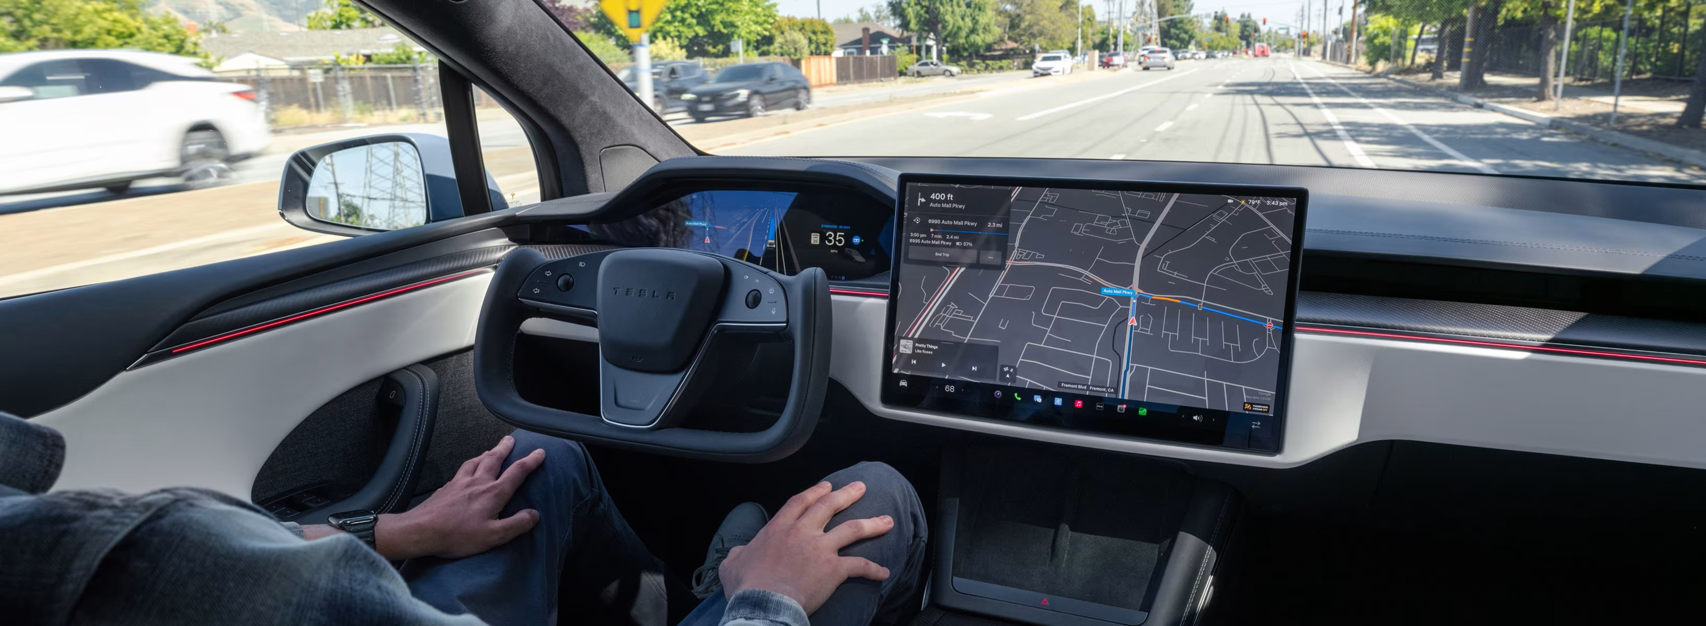
Model S
Overall Performance
Model X has delivered 5.2M units.
Shows a 0.76% YoY growth, indicating slight improvement.
Yearly Trend
Delivery peak occurred in 2022 (504K).
Lowest dip seen around 2020, but strong recovery after.
Recent years maintain consistent performance around 495K.
Financial & Best Year
Average car value for Model X is $84K.
Best-performing year: 2022.
Target vs Delivery
Delivered 5.16M out of 5.54M target, leaving 381K units
undelivered.
Sustainability
Model X contributed 388K tons of CO₂ saved.
Vehicle Specs
Driving range remains stable at 719 miles.
Regional Insights
Strongest deliveries in North America and Middle East.
Europe also shows notable volume.

Slide 7
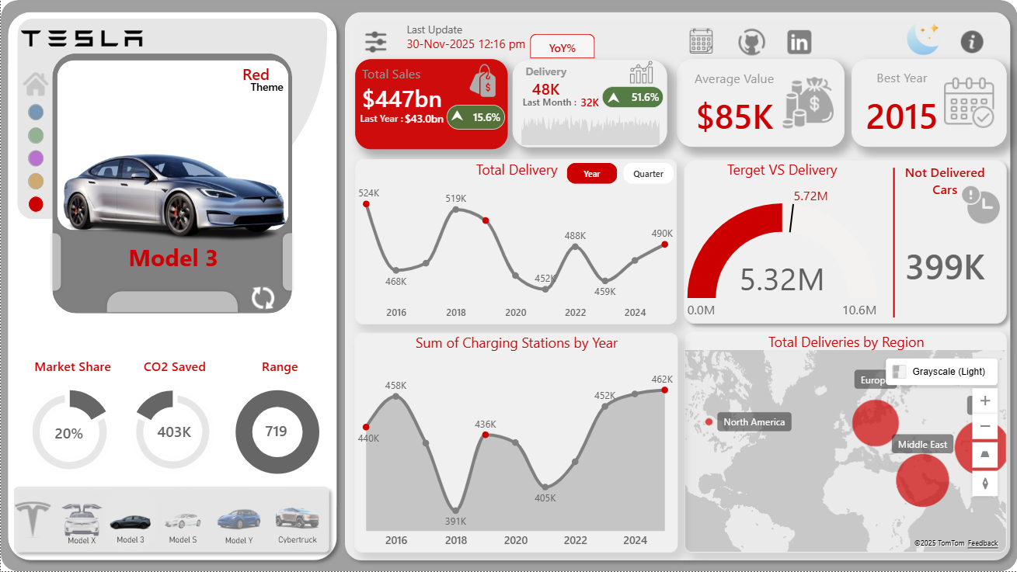


Model 3
Overall Performance
Model 3 delivered 5.3M units overall.
Shows strong performance with +2.8% YoY growth.
Yearly Delivery Trend
Peak delivery in 2015 (524K) and 2018 (519K).
Slight dips in 2020 and 2022, but recovery by
2024–2025.
Latest year delivery sits around 490K.
Value & Best Performing Year
Average value of a Model 3 is $85K.
Best-performing year: 2015.
Target Achievement
Delivered 5.32M against a target of 5.72M.
Around 399K units remain undelivered.
Sustainability
Model 3 contributes 403K tons of CO₂ saved
— one of the highest among models.
Vehicle Specs
Range remains consistent at 719 miles.
Regional Deliveries
Strongest presence in North America and Middle East.
Steady expansion in Europe.

Slide 8
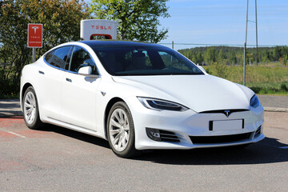

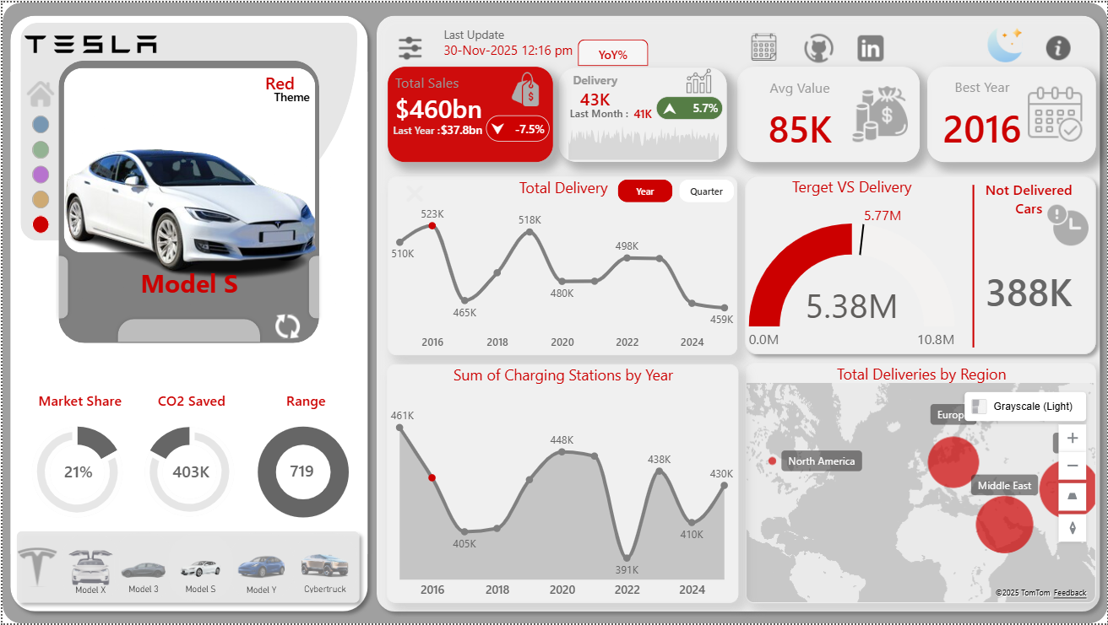
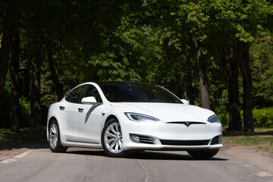
Model S
Overall Performance
Model S delivered 5.4M units in total.
Shows a slight decline with -0.8% YoY growth.
Yearly Trend
Peak performance in 2016, marking its strongest delivery year.
Decline seen in 2023–2025 but stable around 459K–498K units.
Dip around 2020 but recovery afterward.
Value & Best Year
Average value for Model S: $85K.
Best year recorded: 2016.
Target vs Delivery
Delivered 5.38M out of a 5.77M target.
388K units remain undelivered.
Sustainability
Model S contributed 403K tons of CO₂ saved, among the
highest savings.
Vehicle Specs
Range stays consistent at 719 miles.
Regional Insights
Strongest deliveries in North America.
Europe and Middle East also show solid demand.

Slide 9
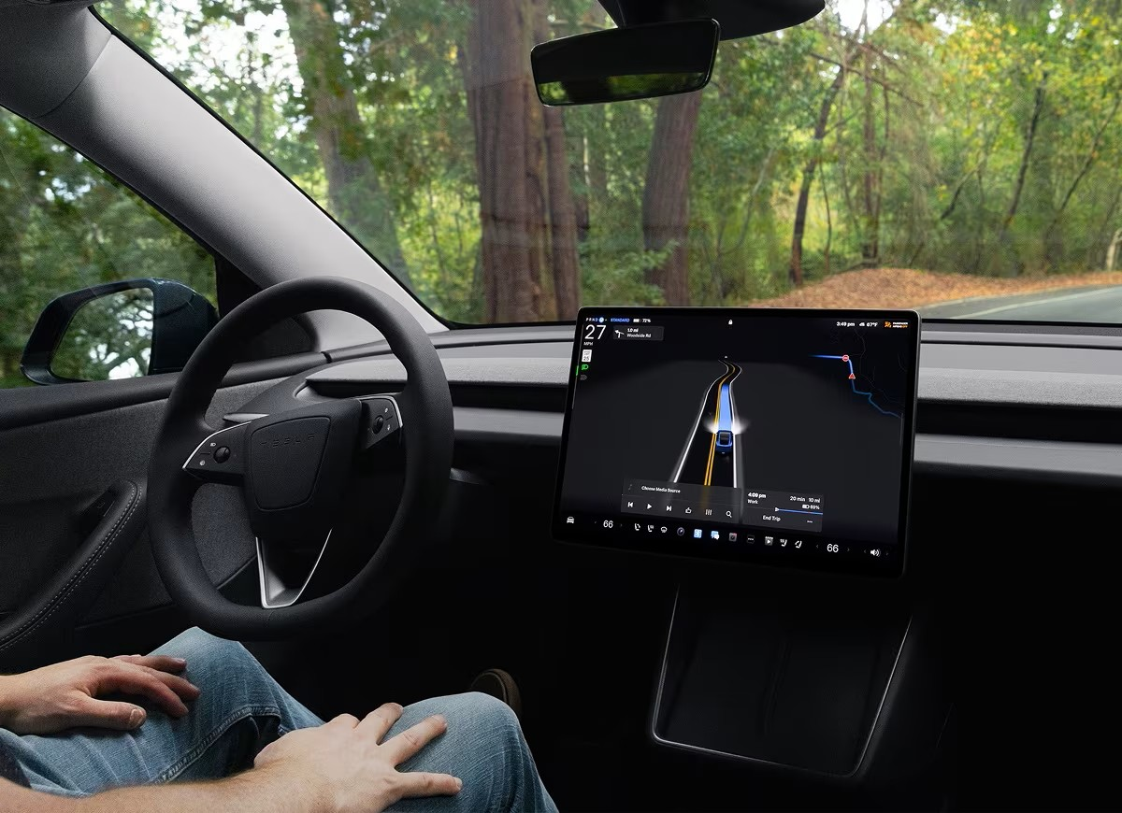
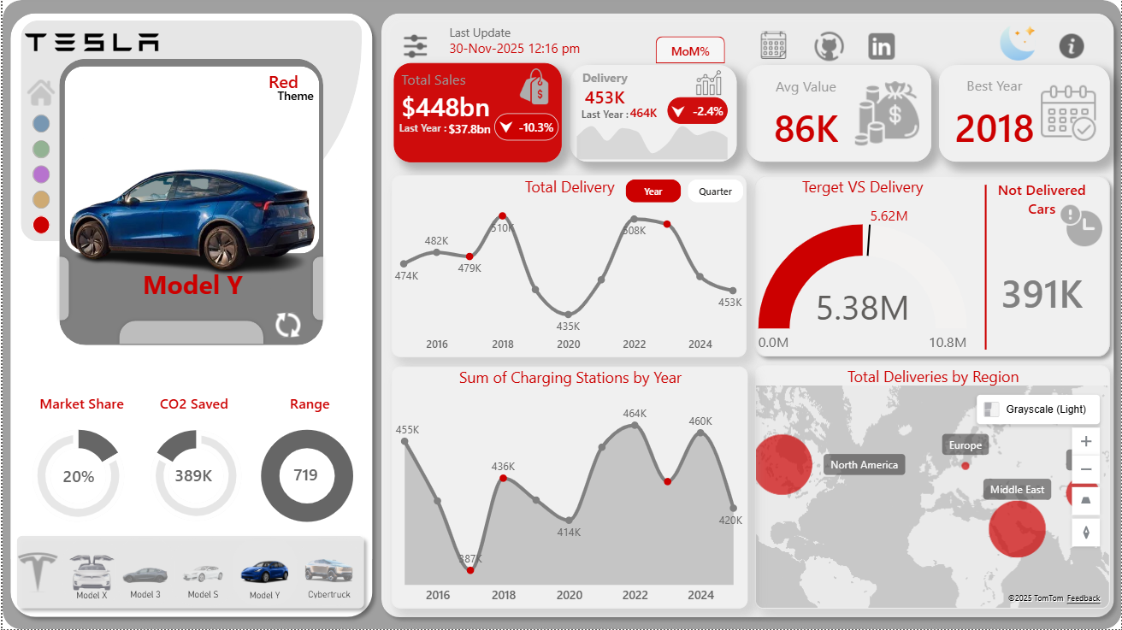
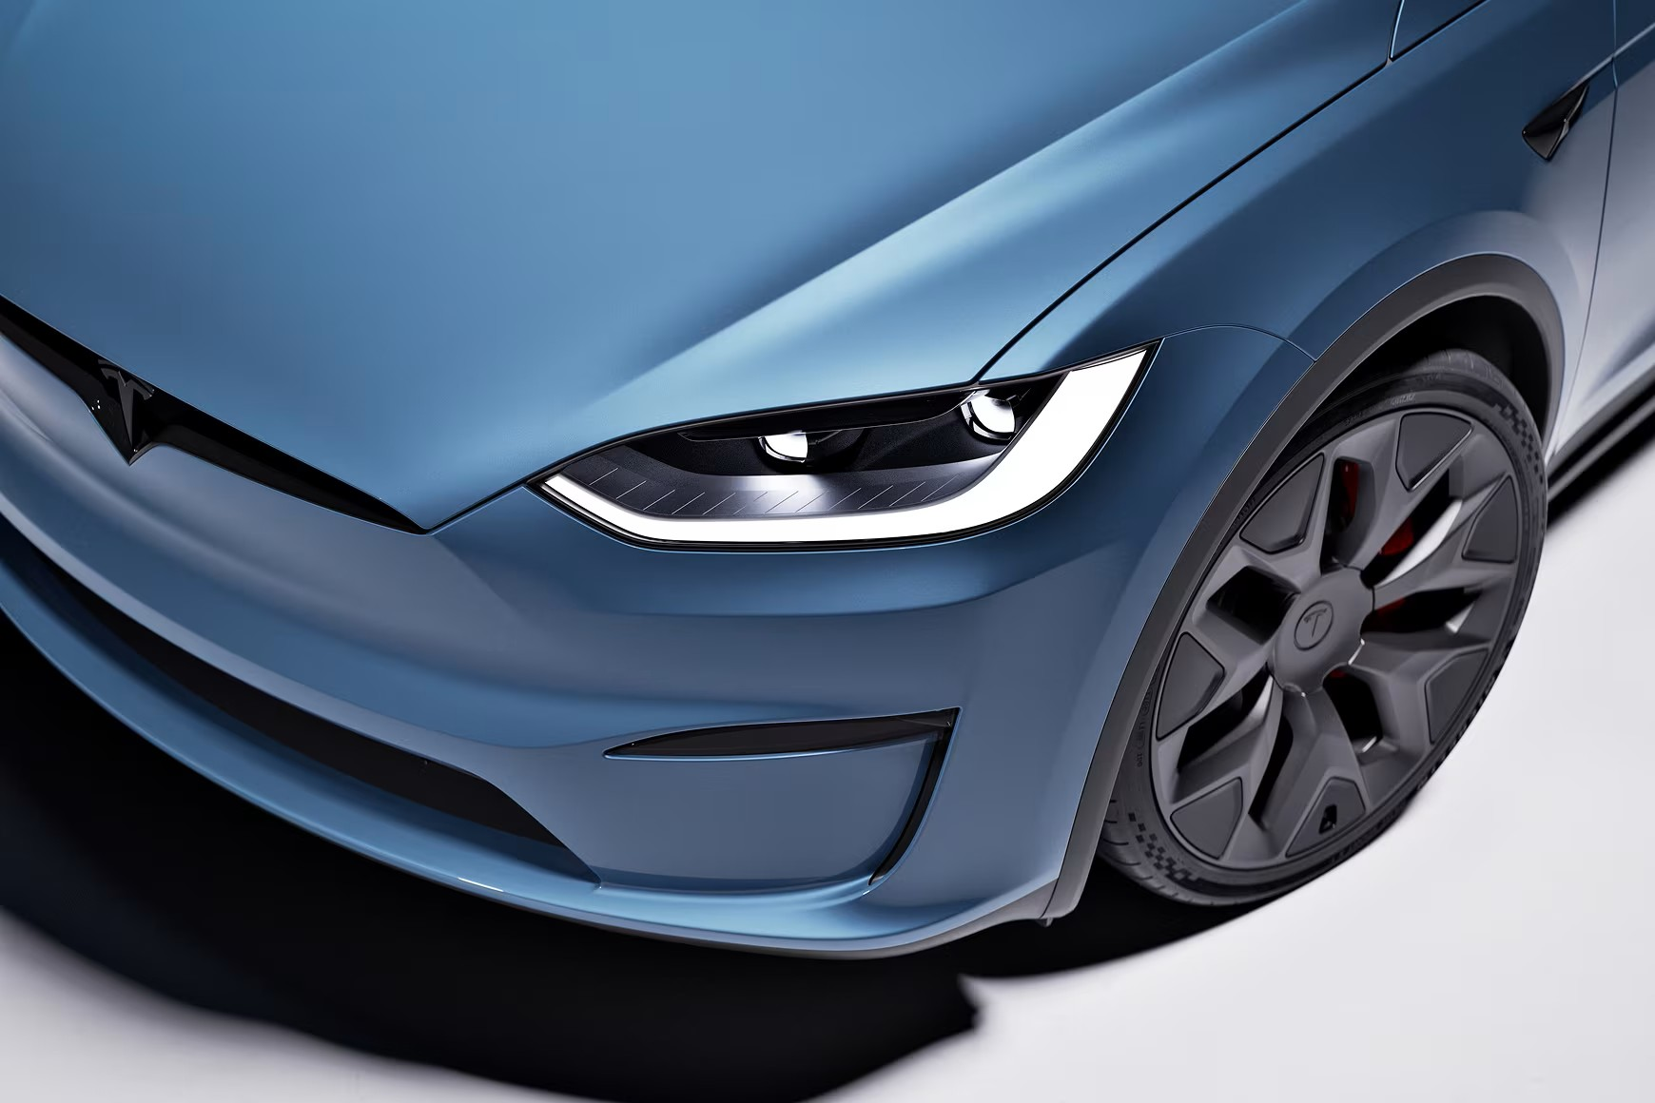
Model Y
Overall Performance
Model Y delivered 5.2M units.
Shows a -2.4% YoY decline, indicating slight slowdown.
Yearly Delivery Trend
Strong peak in 2018 and 2022 (508K).
Lowest point around 2020 (435K).
Recent deliveries stable around 453K.
Value & Best Year
Average value: $86K (highest among models).
Best-performing year: 2018.
Target Performance
Delivered 5.38M against 5.62M target.
391K units remain undelivered.
Sustainability
CO₂ saved: 389K tons.
Vehicle Specs
Range stable at 719 miles.
Regional Insights
Top deliveries in North America and Middle East.
Europe shows moderate but steady demand.

Slide 10

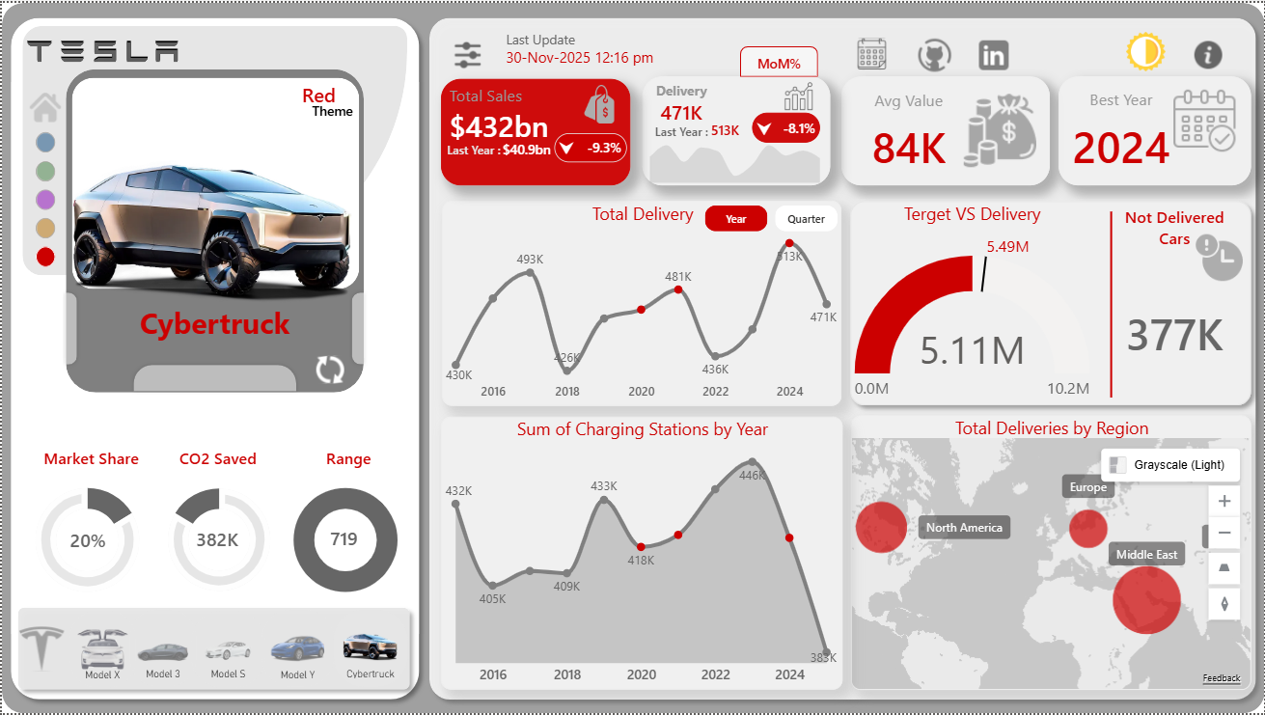
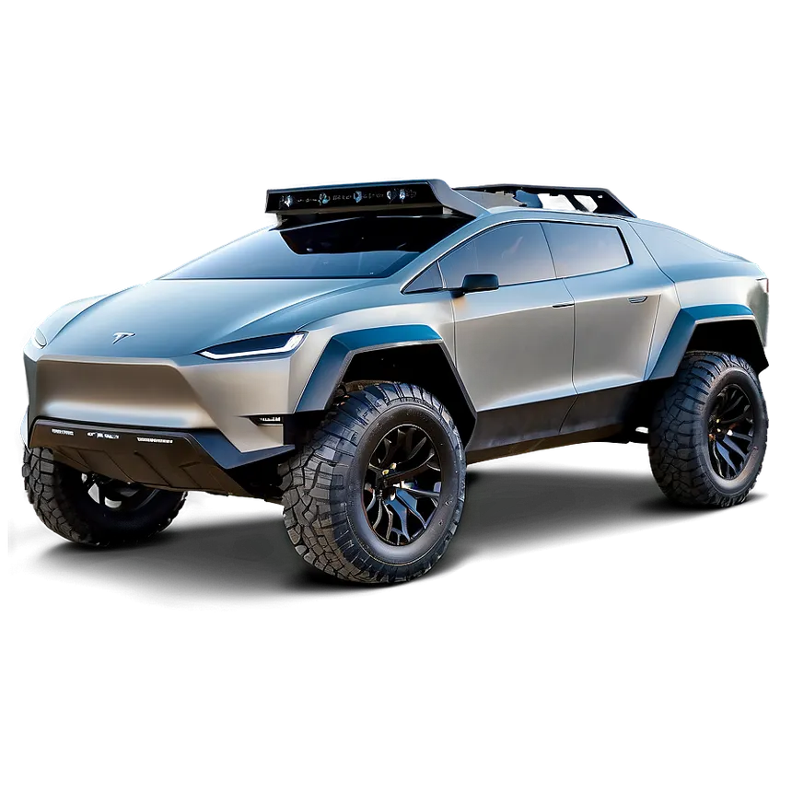
CYBERTRUCK
Overall Performance
Cybertruck delivered 5.1M units.
Facing a -8.1% YoY decline, the sharpest drop among models.
Yearly Delivery Trend
Strong peak in 2024 (513K).
Earlier dips around 2018 (426K) and 2020 (418K).
Latest year delivery at 471K.
Value & Best Year
Average value: $84K.
Best year: 2024.
Target Performance
Delivered 5.11M against a 5.49M target.
377K units undelivered.
Sustainability
CO₂ saved: 382K tons.
Vehicle Specs
Consistent range at 719 miles.
Regional Insights
Highest deliveries in North America.
Strong presence in Middle East, with moderate volume in Europe.

Slide 11

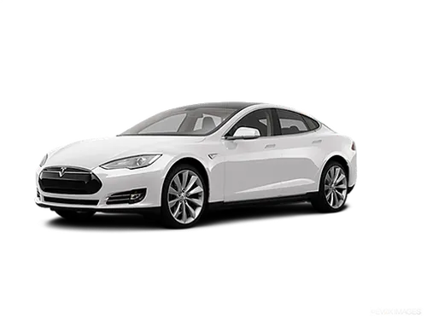
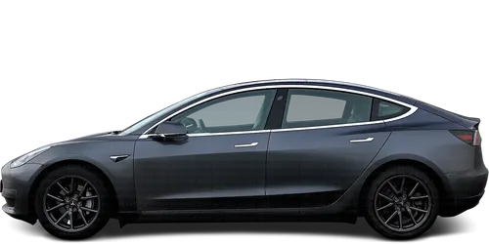
Business Performance Indicators
Total Sales by Model
95%
93%
93%
Model S
Model Y
Model 3
$460B — Highest revenue generator
$448B — Strong performer
$447B — Consistent revenue
90%
90%
Model X
Cybertruck
$432B — Solid contributor
$432B — Growing segment
Target vs Delivery Gap
Charging Infrastructure
Average shortfall: 350K–400K vehicles between expected and actual deliveries
Significant expansion 2016–2024 correlates with higher delivery volumes

Slide 12




Strategic Recommendations
Expand High-Performance Regions
Increase capacity in North America & Europe where demand is strongest
Revitalize Underperforming Models
Re-strategize Cybertruck launches to reverse recent decline
Accelerate Infrastructure Build-Out
Direct correlation between charging stations and delivery success
Close Target-Delivery Gap
Optimize supply chain & manufacturing to improve delivery efficiency
Amplify Environmental Leadership
Market Tesla's superior CO₂ performance — strongest green EV brand positioning

Slide 13


Thank You
Any Question?

